Slide 1

Makaan Website
Presented By
Surendranath
Sunandini
Batch-199

Slide 2
About me
Name : Surendranath J
Qualification: PGDM(Finance & Operations)
Work Experience: Finance & Operations Manager (2.8Years)
Current scenario has more scope for Data Science and Data is the booming industry so I thought to shift my domain into Data Science in terms of growth in my career.
Name : Sunandini
Qualification: BCOM
Work Experience: Quality Analyst
Looking forward to join the booming industry for Data science to pursue my career further interms of growth

Slide 3
Agenda
Problem Statement
Objective of the Project
Web Scraping
Summary of the Data
Exploratory Data Analysis:
Data Cleaning Steps
Data Manipulation Steps
Univariate Analysis Steps
Bivariate Analysis Steps
Key Business Question
Conclusion (Key finding overall)
Q&A Slide

Slide 4
Problem Statement
Find the Best property type which available in Hyderabad.
Find the best property seller according to price and based on areas.
In which price range properties are available.
Objective of the Project
Finding the best property in terms of prices are available in different areas in Hyderabad.
Using the various techniques to visualize the data.

Slide 5
What is Web Scrapping?
Web scraping, also known as data mining, is the process of collecting large amounts of data from the website.
It takes the unstructured data into structured data that can be stored and analyzed , Save the data in a CSV file or some other structured format.
Make a request to these URLs to get the HTML of the page.
Beautiful Soup is a Python library for pulling data out of HTML and XML files.

Slide 6





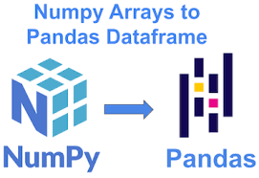

Web Scrapping Tools
Data visualization
Data Cleaning
& Manipulating

Slide 7
Summary of the data
We have selected Makaan website for our web scraping project.
Request to the website
page = requests.get('https://www.makaan.com/hyderabad-residential-property/buy-property-in-hyderabad-city?_=1673412889550')
Import Beautiful Soup and all the necessary libraries for scraping data
check length of all columns and create the DataFrame
Export into .csv format and read csv file and clean the Data
Analysis of Univariate, Bivariate and Multivariate

Slide 8
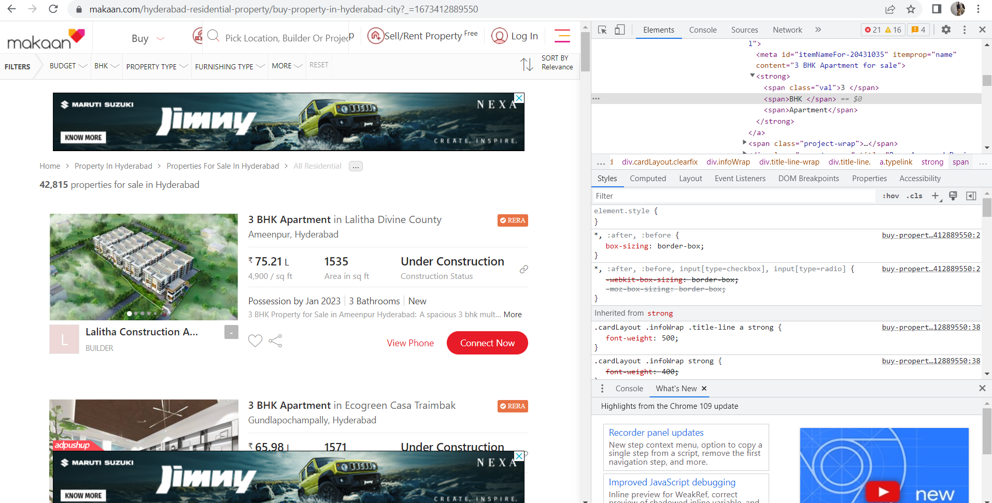
Website used for Scrapping

Slide 9
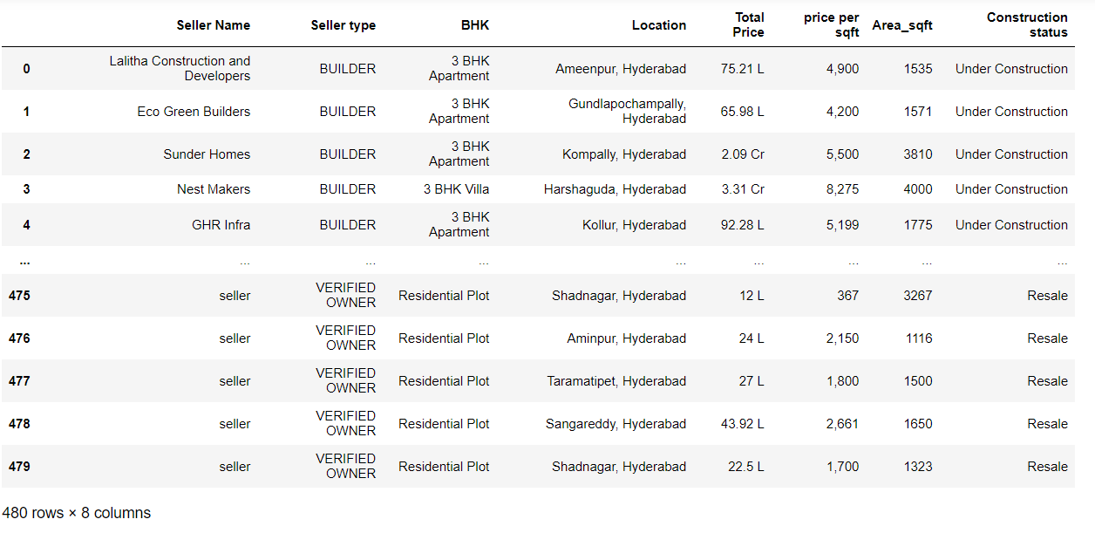
Collected Raw Data From Makaan Website

Slide 10
Exploratory Data Analysis
Data Cleaning Steps:
Check for Duplicates
Drop the duplicate column and unnecessary columns.
Checking and removing special characters.
Identifying and imputing missing values.
Data Type conversion.

Slide 11
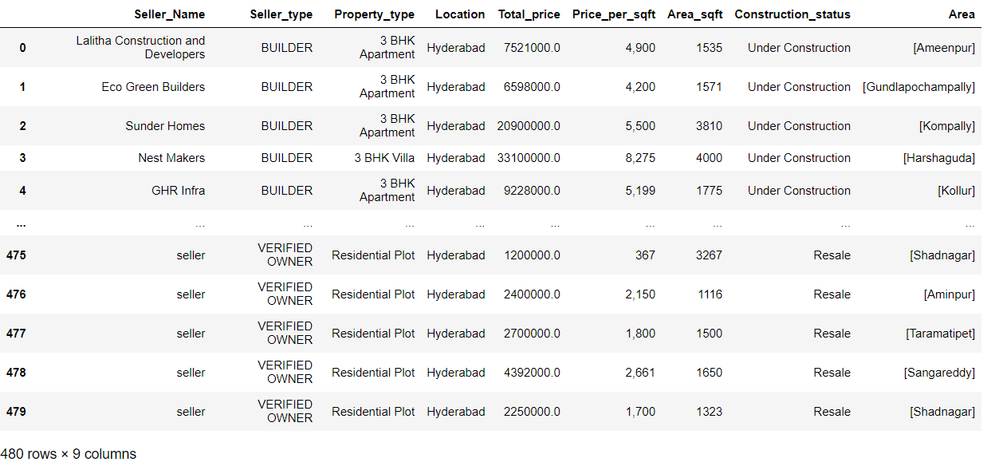
Cleaned Data

Slide 12
Data Visualisation
Univariate Analysis :
Univariate analysis explores each variable in a data set, separately.
Categorical
Numerical
Bivariate Analysis :
Bivariate analysis is a kind of statistical analysis in which two variables are observed against each other.
Categorical & Categorical
Categorical & Numerical
Numerical & Categorical
Multi-variate Analysis :
Multi-variate analysis is a kind of statistical analysis in which more than two variables are observed against each other.

Slide 13
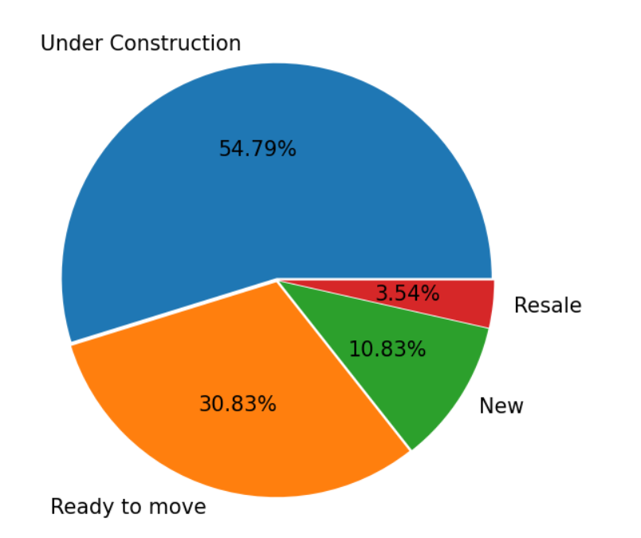
Univariate Analysis :
Observation :
We can observe that most number of properties are under construction stage (54.79%) were second most properties was Ready to Move(30.83%) least was Resale(3.54%).

Slide 14
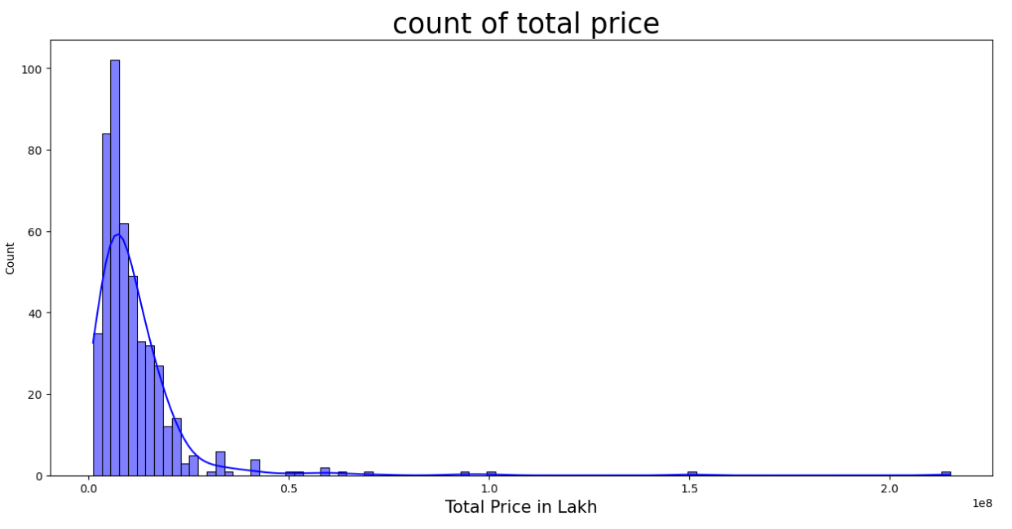
Observation :
We can see that more affordable properties available are in the range of 10 lakh to 50Lakhs.

Slide 15
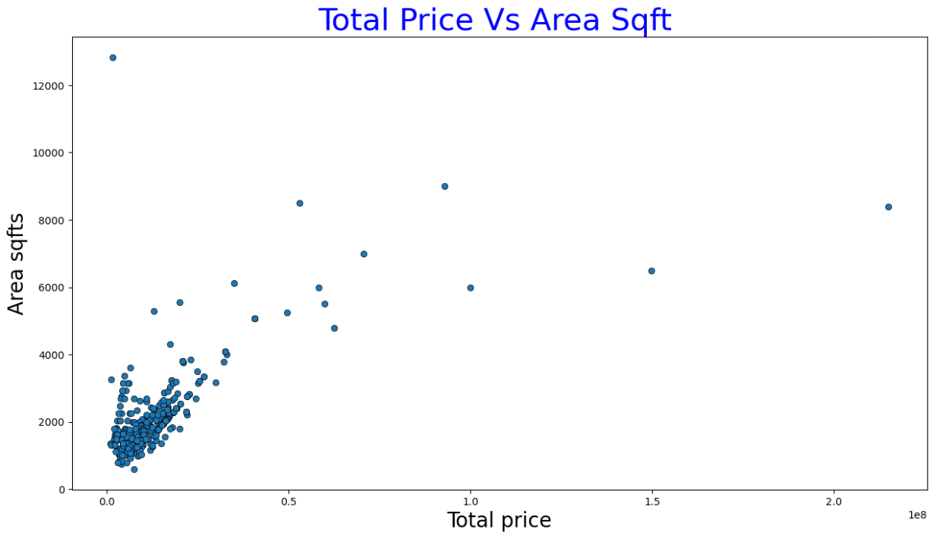
Bivariate Analysis
Observation :
Here we can observe that if area sqft increases then price also increases.
The cluster of dots shows that more number of properties available in the range of 10 lakh to 50Lakhs.

Slide 16
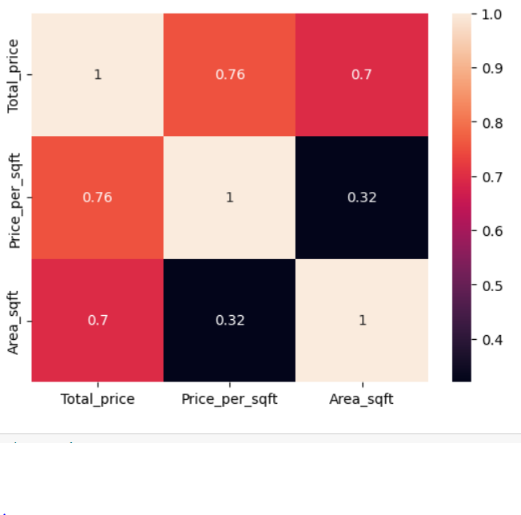
Heat Map of Numerical Values:
Observation :
Here we can observe that if area sqft increases then price also increases.

Slide 17
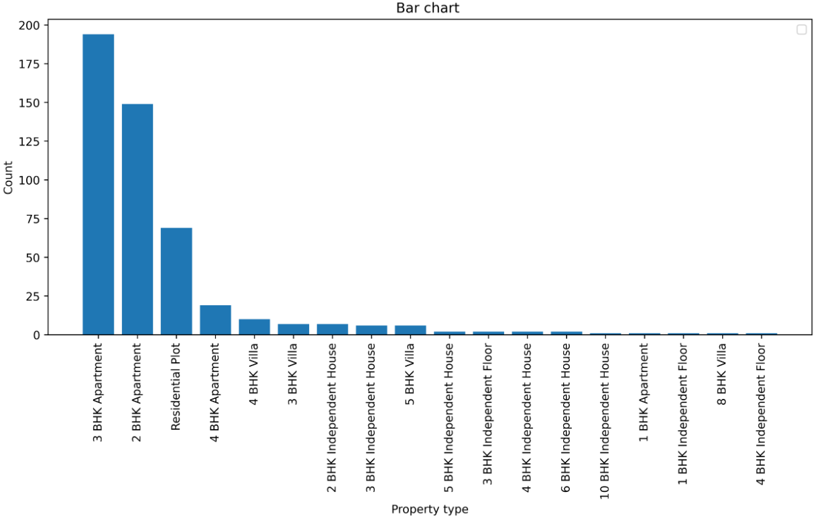
Multi-variate Analysis :
Observation :
Here we can see that most number of properties were sold was 3BHK and 2BHK apartments compare to other properties like Villa and Residential Plots.

Slide 18
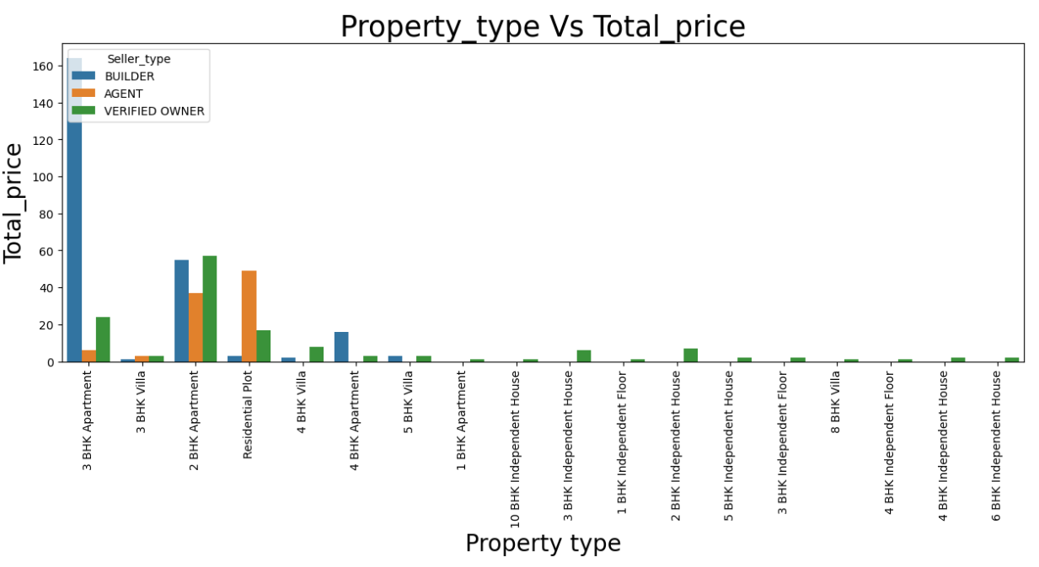
Observation :
Here we can see that most number of properties were sold was 3BHK and 2BHK apartments compare to other properties like Villa and Residential Plots.
The price ranges from between 10L to 1Cr.

Slide 19
Conclusion
Maximum Properties are sold was 3BHk and 2Bhk Apartments compare to other properties like Villa and Residential plots.
Depends on areas were price ranges from '10L to 50L'.
If areaSqft increase prices also increase.
Most of the properties were Under_construction stage and least properties were sold was Resale properties.
Builder has maximum number of properties sold cause were properties on affordabel prices.

Slide 20
Q&A
1. What type of properties are you looking for?
a) 2Bhk b) 3Bhk c) Villa d) Residential plot
Ans:
2. What will be the price of the property should be?
a)25-30L b)30-50L c)50-75L d)75L above
Ans:
3. Which area are you looking property in Hyderabad?....………….
4. How much Sqft should be the property?
a) 1000Sqft b) 2000Sqft c)3000Sqft d)3000sqft above
Ans:
5. What should be the property status?
a) Ready to move b) Under construction c) New plot d) Re-sale
Ans:

Slide 21

THANK YOU

